Slide 1
ENEL 441
Control Systems I
Arne Dankers
10-01-2023

Slide 2
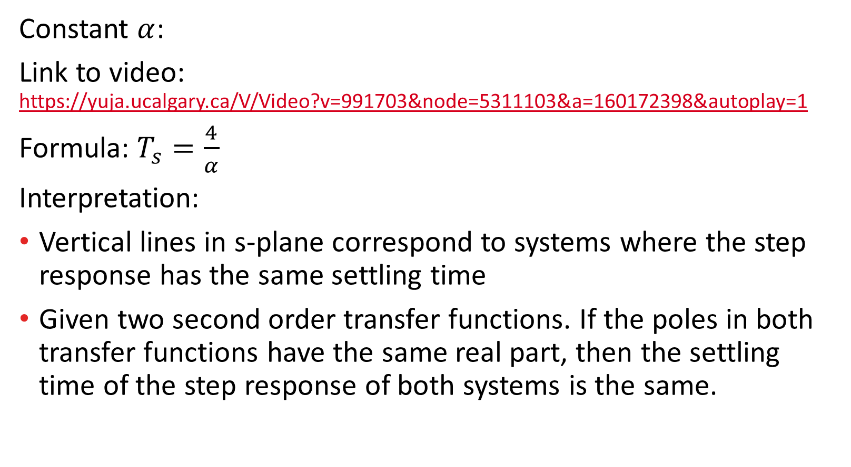
Videos of Step Response
Constant $α$:
Link to video: https://yuja.ucalgary.ca/V/Video?v=991703&node=5311103&a=160172398&autoplay=1
Formula: $T_{s}=\frac{4}{α}$
Interpretation:
Vertical lines in s-plane correspond to systems where the step response has the same settling time
Given two second order transfer functions. If the poles in both transfer functions have the same real part, then the settling time of the step response of both systems is the same.

Slide 3
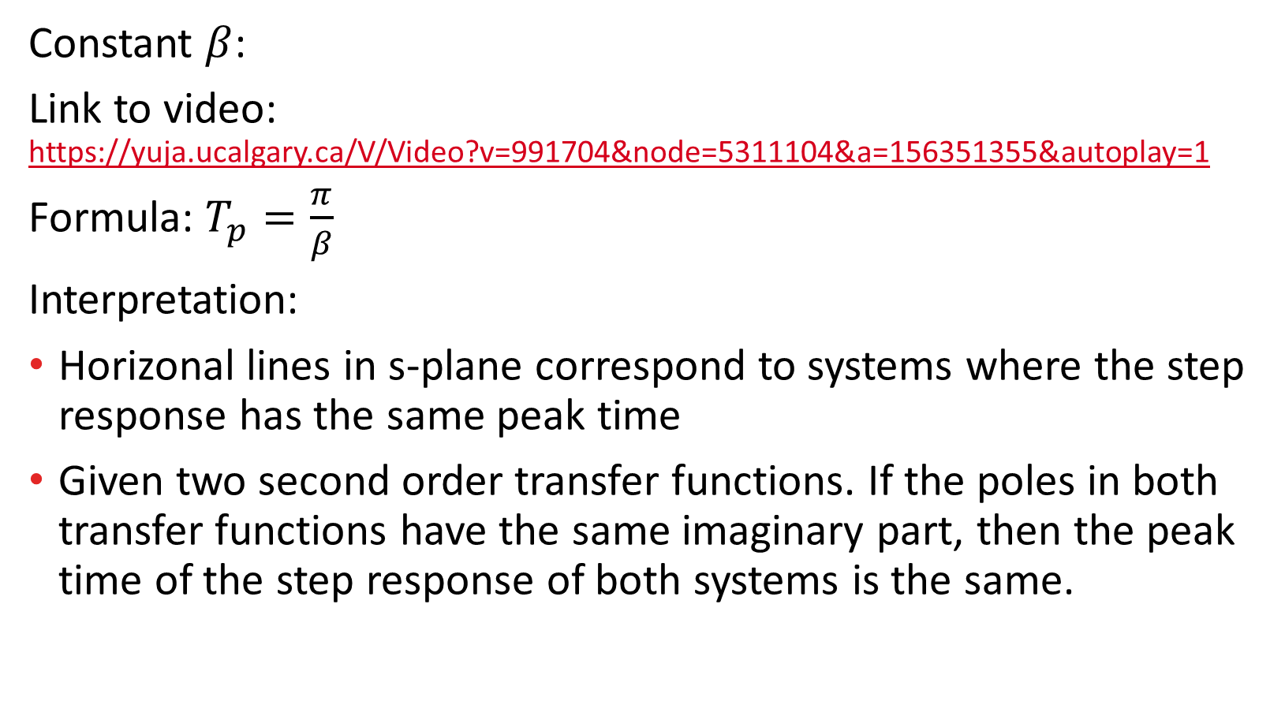
Videos of Step Response
Constant $β$:
Link to video: https://yuja.ucalgary.ca/V/Video?v=991704&node=5311104&a=156351355&autoplay=1
Formula: $T_{p}=\frac{π}{β}$
Interpretation:
Horizonal lines in s-plane correspond to systems where the step response has the same peak time
Given two second order transfer functions. If the poles in both transfer functions have the same imaginary part, then the peak time of the step response of both systems is the same.

Slide 4
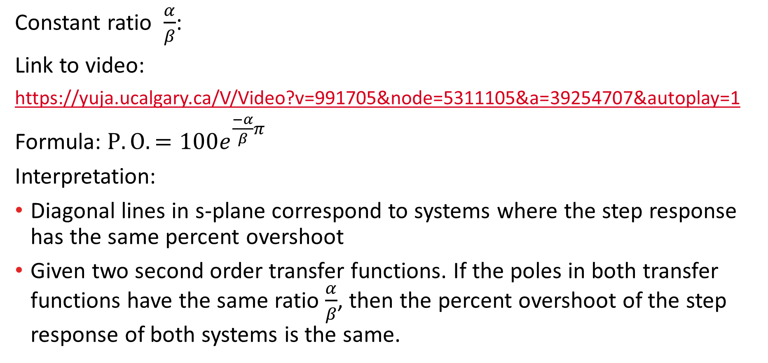
Videos of Step Response
Constant ratio $\frac{α}{β}$:
Link to video:
https://yuja.ucalgary.ca/V/Video?v=991705&node=5311105&a=39254707&autoplay=1
Formula: $P.O.=100e^{\frac{−α}{β}π}$
Interpretation:
Diagonal lines in s-plane correspond to systems where the step response has the same percent overshoot
Given two second order transfer functions. If the poles in both transfer functions have the same ratio $\frac{α}{β}$, then the percent overshoot of the step response of both systems is the same.

